Slide 1
SCOOT
TRB Presentation on SCOOT
January 2000

Slide 2
SCOOT Version 4.2
The most effective traffic adaptive control
system in the world today.
SCOOT stands for:-
S
PLIT
C
YCLE
O
FFSET
O
PTIMIZATION
Method
T
STOPS & DELAYS
ECHNIQUE
FREQUENT, SMALL
ALTERATIONS TO:
- SPLITS
- OFFSETS
- CYCLE TIME
Notes:
SCOOT has been extensively tested in large surveys. The reports on these show that SCOOT control typically saves about 15 per cent delay compared with timings calculated by TRANSYT using up-to-date traffic flows. In addition, to maintain good control and coordination, research has shown that TRANSYT timings need to be updated as traffic flows change (benefit of co-ordination by fixed time plan is lost at approximately 3% per year). SCOOT, because it measures the traffic flow, automatically keeps its timing up-to-date. Therefore, SCOOT would show even greater benefits over out-of-date TRANSYT timings.

Slide 3
System Architecture
Second by second system, with timing algorithms in central processor
Local controller deals with clearance and minimums
Local vehicle actuation determined by traffic engineering priorities
Heirarchical transmission system with flexibility to suit local traffic control needs

Slide 4
SCOOT Principles
Detector processing
Cyclic flow profiles
Traffic model
Optimisers

Slide 5

SCOOT - Schematic Overview
Flow
Phases
Split
&
Offset
Optimizer
Current
SCOOT
Timings
Translation
Array
Demand Profiles
Queues
Preferences
&
Observations
Close Settings
Weights
&
Bias
All Possible Settings
Cycle
Optimiser
Traffic Engineer
Notes:
The traffic model at the root of the SCOOT technique reflects from moment to moment the actual traffic behaviour in the street. This means that there are fewer assumptions about the traffic flow in the network. The effect of signal settings can be predicted accurately whatever the traffic pattern.
The changes that occur due to sports events, road works or accidents will be reflected in the SCOOT traffic model and taken into account by the optimisers. This was intended to be the way SCOOT should work when proposed at TRL. User's experience, gained with a large number of systems, confirm that SCOOT is extremely effective in coping with such events.
Because the SCOOT traffic model is separate from the optimisers the engineer who is installing the system has a clear objective when instrumenting the network. SCOOT loop design and positioning has the one aim of producing a real time model of the traffic crossing each stop-line. However different the traffic situation is in one city from another the requirement to be met is that the traffic model reflects the traffic demand on each link.

Slide 6
SCOOT Systems around the World
Red Deer
Toronto
Halifax
London
Minneapolis
Oxnard
Arlington
County
Madrid
Cyprus
Dalian
Anaheim
Beijing
San Diego
Orlando
Bahrain
Chiang Mai
Hong Kong
Dubai
Bangkok
Sao Paulo
Durban
Santiago
Port Elizabeth
Cape Town
101 Systems Worldwide

Slide 7
SCOOT - Where will it work?
SCOOT works on both Arterial Streets and Grid Networks
  Arterial streets - examples
    Toronto - Lake Shore Boulevard
    London - Cromwell Road
    Oxnard, Ca
    Sao Paulo - Rio Branco
  Networks - examples
    Toronto - CBD
    Dubai
    London - West End
    Madrid - Central area
SCOOT works on networks from <10 intersections to >1000
  Cambridge (UK) - 9 nodes initially
  Sao Paulo (Brazil) >1000 nodes
Notes:
Putting SCOOT to work is something which Siemens takes great care to teach our customers. For example, in Toronto, although Siemens engineers played a major role in the commissioning and validation of the initial network of 85 intersections, the expansion pprogramme currently under way to add approximately 200 further intersections will be handled entirely by the customer.
The greatest benefits are obtained from SCOOT when the areas of the network to be controlled are approaching saturation. However, in a less heavily loaded network, the efficiency of SCOOT control can delay the onset of congestion (in macroscopic terms by months or years, as traffic levels increase, and in microscopic terms, by hours, or several tens of minutes, for each individual peak period). The use of SCOOT can allow the postponement of major road construcion programmes.
SCOOT won’t always guarantee no congestion. Many cities are so over-saturated that no system could possibly cope all the time, but in the words of a London policeman, “If Trafalgar Square reaches gridlock, then we know SCOOT is broken. But any other system would be broken then too, and SCOOT fixes the problem quicker than anything else we have seen”.

Slide 8
Data Requirements
Detection on every link for which full optimization required
Detectors generally located at upstream end of link
Connection to central computer achieved via upstream intersection
Links with no detection run fixed length or can have data derived from upstream links
  Fixed length phases can be varied by time of day

Slide 9
Positioning SCOOT detector loops
Notes:
In a network of intersections (or along an arterial street), the SCOOT detectors are normally placed just far enough downstream from the upstream intersection that the vehicles crossing the detector have reached their normal cruising speed. The detectors are then connected to the system via the controller at the upstream intersection.
An exception to this general rule would be made if a significant sink or source of traffic (e.g. an unsignalled intersection, major parking lot entrance / exit) exists along the link. In that case, the loop could well have to be situated downstream of the sink / source.
For entry links to the system, the loop would be placed 100 to 150 metres back from the stop line (far enough away from the stop-line to be beyond the back of the queue in most normal circumstances.
The minimum distance from loop to stop-line would normally allow a vehicle travel time of seven seconds from loop to stop-line. In exceptional circumstances, this could be reduced to four econds.

Slide 10
Communication
Dedicated multi-drop transmission lines to outstations
Second by second communications to and from outstation
Typically six to eight intersections / drop @ 1200 Baud

Slide 11
Control Variables
modelling uses measured vehicle demand (occupancy) and calculated queue length
optimization uses demand (flow profiles) and calculated delay/saturation
approach is to make small, regular changes to timings to minimize transients
seven primary validation parameters (to correlate internal traffic model with the real world)
dozens of parameters to allow the traffic engineer to tune system performance
  a full library of default values is provided
  these are changeable by time-of-day, or manually

Slide 12
Data Sampling, Filtering and Smoothing
Detection based on vehicle occupancy
Detector is typically a loop, with length 2m in direction of travel
Sampling rate is 0.25s
Algorithm processes raw data into LPUs based on linear discounting
Demand profile for each link is built up in four second increments
Controller phase replies used to enhance modelling

Slide 13
Generation of SCOOT Demand Profile
Cyclic Flow
at the
Detector
Dispersion Model
Journey Time
Stopline Demand

Slide 14
Queue Model
Flow Rate
Time now
Cyclic Flow Profile
Cruise
speed
Saturation flow rate
Flow adds to
back of queue
ACTUAL
QUEUE
Modelled queue at time’now’
Time ‘now’
Stop Line
Red time
Green time
Notes:
The blue shows stationary traffic against time. Therefore the blue area represents delay.
SCOOT is continually making such a calculation on every link in the network. Hence, if by adjusting the split, the area of blue can be reduced then stops, delay and congestion will all have been reduce.
If SCOOT has calculated that more traffic will benefit by extending the stage currently running then it will do so.

Slide 15
The Optimisers
Optimizer
Frequency
Change Time
(seconds)
Split
Every stage
-4, 0, +4 (Temporary)
change
-1, 0, +1 (Permanent)
Offset
Once per
cycle
-4, 0, +4
-4, 0, +4 (32 to 64)
Cycle
Time
Every 2.5
or 5 mins
-8, 0, +8 (64 to 128)
-16, 0, +16 (128 to 240)

Slide 16
SPLIT Optimizer
Aim
  Equalise saturation + congestion
  Considering one stage at a time
Method
  All upstream and filter links at a node
  Link merit values for advance, stay and retard
  Move stage change time by -4, 0, +4
  Revert to permanent change of -1, 0,+1
  (Standard values for adjustment quoted - may be varied by the user)
Notes:
The split optimizer works on the traffic model just before each stage change. It considers the effect of advancing, retarding or holding the stage change and the effect this has on the green duration. The test it uses is the degree of saturation of all links controlled by the node. The degree of saturation is defined as 'The ratio of the average flow to the maximum flow which can pass a stop-line'. 'The ratio of the demand flow to the maximum possible discharge flow' in SCOOT terms it is the ratio of the demand of the Cyclic flow Profile to the demand of the discharge rate (Saturation Occupancy) multiplied by the duration of the effective green time. The Split optimiser will try to minimise the maximum degree of saturation on links approaching the node. If the average degree of saturation over a five minute period is greater than 90% then the cycle time will increase to give more capacity at the critical node. This has been shown to minimise delay.
If congestion is present on the approach to the node then this must be taken into account by the split optimiser. To enable this the proportion of the previous cycle that was congested is included with the degree of saturation used by the optimiser when making its decision. The congestion term will enable a congested link to tend to obtain more green time whatever the degree of saturation shown in the model, depending on the congestion importance factor set for this link .

Slide 17
SPLIT Optimizer
Frequency
  Once per stage change
  5 seconds before stage change time
Constraints
  Minimum and maximum stage lengths
  Fixed length stages
  Split weighting
Feedback
  Adjust optimiser for stages which do not appear

Slide 18
OFFSET Optimizer
Aim
  Minimise delay and stops + congestion
  Considering one node at a time
Method
  Each upstream and downstream normal link
  Link performance index for advance, stay and retard
  Minimise sum of PI’s for all the links
  Move stage change time by -4, 0, +4
Notes:
The cyclic flow profiles, are used by the offset optimizer to predict the queue length throughout the cycle. Once a cycle the offset optimizer predicts the queue lengths for all the links upstream and downstream of a particular node. The effect of 'moving' the nodes 'time' forward or backward by a small amount is predicted for these links. As the time of arrival of traffic at the stop-line is shown in the profiles, these predictions can be used to minimise the stops and delays in the mini-area.
The choice is made for minimum delay and stops. The average length of queue gives delay. The volume of traffic arriving whilst there is a queue will give the number of stops.
The congestion on a link is also used in the offset optimiser so that the congested link is given priority over links without congestion. The degree of priority is related to the degree of congestion.

Slide 19
OFFSET Optimizer
Frequency
  Once per region cycle time
  During nominated stage
Constraints
  Offset weighting
  Fixed and biased offsets
Feedback
  No account of stage demands

Slide 20
CYCLE Optimizer
Aim
  Minimise delay
  Considering one region at a time
Method
  Minimum practical cycle time for each node at 90% normal saturation or 80% target saturation
  Consider range from maximum MPCY to maximum region cycle time
  Consider double cycling if possible
  No preset critical node
Notes:
The cycle optimiser usually runs every 5 minutes. At this time it will work out the degree of saturation at all the stop-lines for each node. If any are above 90% saturated the minimum practical cycle time is increased by a small fixed step. If all are below 90% then the minimum practical cycle time is reduced by a small fixed step. The optimiser considers all cycle times from the highest minimum practical cycle time of any node (which therefore can be considered as the “critical” node) up to the maximum region cycle time operating at that time. These are considered "trial cycle times".
There is provision within SCOOT for the optimiser to run twice as often if a trend of rising or falling flows has been established.
To reduce delays at very lightly loaded junctions the cycle optimiser will 'double cycle' these junctions if the delay is reduced in the network by this action. Because this can show reductions in delay if the cycle time is changed by large amounts, the cycle optimiser is the only optimiser that looks at the effect of large changes. However large changes in Cycle time are very disruptive so SCOOT does not make the change in one step. The change made will be in small steps but the direction of movement will have be chosen by reference to consideration of a larger change.
The Cycle Time Optimiser operates on a region of nodes that have progression between them. This is chosen by the Engineer.

Slide 21
CYCLE Optimizer
Frequency
  Usually every 5 minutes
  Every 2.5 minutes when cycle rising
  Every 2.5 minutes when cycle is falling (if required)
Constraints
  Maximum region cycle time
  MPCY’s of nodes
  Minimum node cycle time
  Forced single cycle or forced double cycle (if possible)
Feedback
  Stage demands taken into account

Slide 22
Phasing Flexibility - SCOOT to Dual Ring NEMA Controller translation
3
1
8
6
2
3
1
8
4
6
7
5
4
2
7
5
SCOOT stages - Method A
1 |--------- 2 ----------| 3 |---------- 4 -----------|
SCOOT stages - Method B
1 2 3 4 5 6
Notes:
One method used allows the controller a large amount of freedom under low flow conditions, while still maintaining SCOOT co-ordination and optimisation under heavy traffic conditions. In Low flow conditions, the controller is allowed to cycle to the next phase if demand finishes before SCOOT wishes to move, the controller will the eventually move to the co-ord stage where SCOOT will synchronise. In High flow conditions, as the demand is unlikely to finish before SCOOT wishes to move on, SCOOT will be in total control to manage queues to the set-up requirements.
An alternative method provides slightly more control. For each locally actuated phase, a “permission” is sent out from the central computer, and the controller is allowed to move to the phase if a demand exists on street. If no demand exists the controller will not be forced to move to that phase. For each succeeding actuated phase, the permission will be sent out at an appropriate point in the cycle.

Slide 23
Measures of effectiveness
Optimization targetted in general at minimising delay
  User specifies relative importance of stops and delay
Split at a node balances degree of saturation on adjacent links
  subject to weighting parameters from the local traffic engineer
Offset determined by node performance index
  choose best offset to minimise stops and delays on all adjacent links
Cycle time maintains all links at no more than 90% saturation

Slide 24
MOE’s
Data from SCOOT to demonstrate how it is achieving the above targets?
“Event Driven messages” from SCOOT M02 / M03 / M04
    02 = link
    03 = node
    04 = region
  Stops ( vehicle.stops / hour )
  Delay ( vehicle.hour / hour )
  Flow ( vehicle / hour )
  Congestion ( intervals / hour )
All this data can be processed by ASTRID

Slide 25
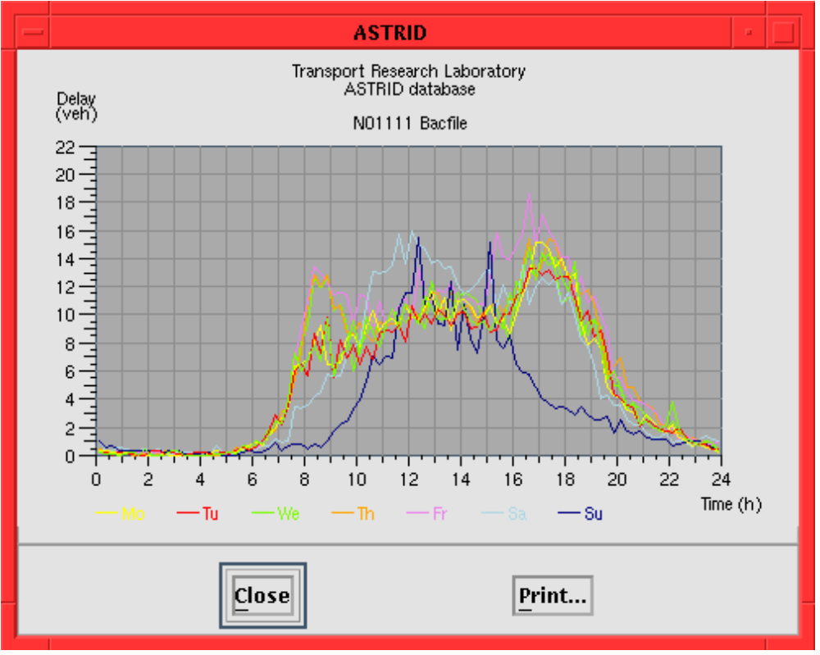
ASTRID Database
Notes:
The graph above depicts the amount of delay modelled by SCOOT on one particular intersection over the twenty four hours of the day , for each day of a week.
This is typical of the type of output available from the ASTRID package.

Slide 26
Transit Priority
Transit priority is a standard feature within SCOOT V3.1
Dealt with by optimizing the priority provision
  Extensions to running stage
  Recall on minima via normal stage sequence to bus stage
  Recovery to previous offset as quickly as possible
  AVL and loop detection
Notes:
Transit Priority within SCOOT can make use of Active Vehicle Location (AVL) Systems (interface in the Central Office) or Selective Loop detection (interface at the local controller) to detect the presence of an approaching bus. SCOOT then determines the best method of giving priority to the bus, either by providing extensions to the current running stage or issuing recalls to return to the appropriate stage. Once priority has been completed, SCOOT can then use a number of methods to rapidly return the optimal offset and stage lengths for the prevailing traffic conditions.

Slide 27
Fire Priority
Fire priority is a standard feature within the SCOOT system
Optimization suspended during absolute priority, but modelling continues
  Fast recovery to normal conditions at end of priority period
V4.2 has recovery algorithms (not the same as bus priority)

Slide 28
Special Features for Oversaturated Conditions
Congestion importance factors / congestion offset per link
Congestion links with congestion importance factors
Gating
Variable Node Based Target Saturation for cycle time optimisation

Slide 29
Congestion Importance Factors / Congestion Offset
Congestion Importance Factor is specified for each link
  Used to influence Split calculations in favour of the link, when congestion is detected
Congestion Offset is a fixed offset, specified by the Traffic Engineer, to be used in congested conditions
  Congestion Weighting Factor allows the engineer to specify the importance of achieving the Congestion Offset
Notes:
Congestion Offset. When a link congests it needs a different offset to normal. It may be that the free running offset is giving advantage in congested conditions to the wrong entry to the link. This would favour diversion of traffic which the Traffic Engineer might choose to discourage. When congested the offset required is very predictable and SCOOT can switch to it as congestion is confirmed. The Congestion Weighting parameter is set by the traffic engineer to determine how strongly the Offset will be moved to the Congestion Offset.
Congestion Importance Factor. This factor is applied to each link according to the importance of congestion appearing on the link and how quickly it should be dealt with. The amount of congestion on a link is determined by the number of congested intervals each cycle. A detector has to be continuously occupied for the whole of a SCOOT interval (4 seconds) for 1 congested interval to be recorded. Using a combination of the number of congested intervals and the value of the congestion importance factor, SCOOT then weights the green split in favour of that link.

Slide 30
Other Features
SOFT (on-line calibration of sat. flow)
Use of alternative existing detection (although some reduced efficiency results)
Variable authorities (i.e. variable bounds on optimiser decisions)
Flared approaches (V4.2)
Notes:
The saturation occupancy of a link is usually determined from vehicle count and timing measurements made on-street. The software provided under the on-line saturation flow technique (SOFT) gathers information from vehicle detectors at the exits from the intersection. This enables the saturation value to be adjusted by the on-line software, improving SCOOT'‘s reaction to incidents that change the network. The SOFT technique is normally applicable to a proportion of the links in a SCOOT network, where sufficient downstream detectors are available. Links suitable to use the technique must be determined during validation of the network.
Use of existing detection was trialled in the Anaheim FOT
User Configurable Optimizer Authorities provides the user with control of the authority levels for the Split and Offset optimizers. The authority is the amount by which the optimizer can affect the offset (in the case of the Offset optimizer) or the stage change point (in the case of the Split optimizer). In previous versions of SCOOT these have been fixed but the values are now user configurable to provide a greater degree of flexibility and speed of response to the traffic conditions.

